Slide 1

.
“Efficacy of Government Schemes in a Public School - A Case Study Of Malihabad”
Submitted to :
Isabella Thoburn College, Lucknow
Department of Economics
Session : 2023-24
Supervised by :
Dr. Amita Marwha
Assistant Professor
Department of Economics
Isabella Thoburn College
Submitted By :
Anshika Chandra
BA 3rd Year (2021-24)
Roll Number: 214154
University Roll Number: 2110381010075

Slide 2
Table of Contents
S.No. | Topic | Page Number
1. | Acknowledgement
2. | Chapter 1 – Introduction
3. | Chapter-2 : Literature Review
4. | Chapter 3 : Research Methodology
5. | Chapter 4 : Data Analysis And Interpretation
6. | References

Slide 3
Acknowledgement
The successful completion of this report is a testament to the invaluable contributions of those who guided me throughout this endeavor.
I extend my heartfelt gratitude to our esteemed principal, for granting us the opportunity to undertake this significant assignment.
I would also like to express my sincere appreciation to Prof. Anupma Srivastava, Head of the Department of Economics, whose insights, counsel, and guidance greatly enriched the quality of this work.
Last but not least, I offer my special thanks to Dr. Amita Marwah Ma’am for her unwavering guidance in the completion of this report. I cannot overlook the unwavering support of my family and friends throughout this journey, which has been a constant source of encouragement and inspiration.

Slide 4
DECLARATION
I, Anshika Chandra, under the supervision of Dr. Amita Marwha, verify that the dissertation report is an original and exhaustive attempt and if at any stage my dissertation comes under plagiarism, I would be solely responsible.
Anshika Chandra
BA Economics Year 3rd Semester 6th
University Roll Number - 2110381010075

Slide 5
Chapter-1 : Introduction
In India, government schemes aimed at enhancing the quality of education in public schools have been pivotal in addressing the challenges of access, equity, and quality in the education sector. These schemes encompass various initiatives ranging from infrastructure development to teacher training and student welfare programs. However, the efficacy of these schemes often varies across different regions and schools, influenced by factors such as socio-economic conditions, administrative capacities, and local community involvement.
This study focuses on examining the efficacy of government schemes in a specific public school situated in Malihabad, a rural area in India. Malihabad serves as a pertinent case study due to its unique socio-economic profile and the implementation of diverse government interventions aimed at improving educational outcomes.
The significance of this study lies in its potential to provide insights into the practical implications of government schemes on the ground level, thereby contributing to the ongoing discourse on educational policy and program effectiveness in India. By evaluating the implementation of these schemes and their impact on the Malihabad public school, this research aims to offer valuable perspectives for policymakers, educators, and stakeholders involved in the education sector.
Objectives of the research include assessing the extent to which government schemes have contributed to the improvement of infrastructure, teaching quality, and overall educational outcomes in the Malihabad public school. Furthermore, the study seeks to identify challenges faced in the implementation process and potential strategies for enhancing the efficacy of these schemes.
This introduction provides a brief overview of the case study, outlining its importance within the broader context of educational development in India. Subsequent sections will delve into a comprehensive review of existing literature, the research methodology employed, data analysis and findings, discussions, and concluding remarks, thereby presenting a holistic analysis of the efficacy of government schemes in the Malihabad public school.

Slide 6
The following Centrally sponsored programmes are being implemented in the Education Sector under Ministry of Human Resource Development:
Sarva Shiksha Abhiyan (SSA)
Kasturba Gandhi Balika Vidyalaya
National Programme for Education of Girls at Elementary Level (NPEGEL)
Mid Day Meal Scheme (MDMS)
Mahila Samakhya
Rashtriya Madhyamik Shiksha Abhiyan(RMSA)
Scheme for setting up of 6000 Model Schools at Block level as Benchmark of Excellence
Scheme for construction and running of Girl’s Hostel for Secondary and Higher Secondary Schools
Scheme of Vocationalisation of Secondary Education at +2 level: Initiated in 1988, this centrally sponsored scheme of Vocationalisation of Secondary Education provides for diversification of educational opportunities so as to enhance individual employability, reduce the mismatch between demand and supply of skilled manpower and provides an alternative for those pursuing higher education.
Hence, it is important and would be implemented from class IX onwards, unlike the present provision for its implementation from class XI, and would be subsumed under RMSA.
Vocational Education courses will be based on national occupation standard brought out by the Sector kill Councils (SSCs) that determine the minimum levels of competencies for various vocations. Academic qualifications would be assessed and certified by educational bodies and vocational skills would be assessed and certified by respective SSCs.
In the Twelfth Plan, a mechanism would be created for convergence of vocational courses offered by various ministries, private initiatives and vocational education institutions, and use schools as the outlet for vocational education of young people. A comprehensive repertoire of vocational courses, duration of each course, equipment and facilities, costs and agencies will be developed.

Slide 7
Inclusive Education for the Disabled at Secondary School (IEDSS): Inclusive Education for Disabled at Secondary stage: The Scheme of Inclusive Education for Disabled at Secondary Stage (IEDSS) has been launched from the year 2009-10.
This Scheme replaces the earlier scheme of Integrated Education for Disabled Children (IEDC) and would provide assistance for the inclusive education of the disabled children in classes IX-XII.
The aim of the Centrally Sponsored Scheme of IEDSS is to enable all students with disabilities, after completing eight years of elementary schooling, to pursue further four years of secondary schooling (classes IX to XII) in an inclusive and enabling environment.
Quality Improvement in School: During the 10th Five Year Plan, “Quality Improvement in Schools” was introduced as a composite centrally sponsored scheme having the following components: i) National Population Education Project, ii) Environmental Orientation to School Education, iii) Improvement of Science Education in Schools, iv) Introduction of Yoga in Schools, and
v) International Science Olympiads. A decision was taken to transfer four of these components to National Council of Educational Research and Training (NCERT) w.e.f. APRIL 2006, except the component of improvement of Science Education in school that was transferred to States.
Strengthening of Teachers Training Institutions: The Right of Children to Free and Compulsory Education (RTE) Act, 2009 poses major challenges for improving the quality of teachers and for expanding institutional capacity in States to prepare professionally trained persons for becoming school teachers.
Government has initiated steps to revise the existing Centrally Sponsored Scheme of Restructuring and Reorganisation of Teacher Education.
This Scheme was initiated in 1987 pursuant to the formulation of the National Policy on Education, 1986 which emphasised the significance and need for a decentralised system for the professional preparation of teachers, and it was in this context that District Institutes of Teacher Education (DIETs), Colleges of Teacher Education (CTEs) and Institutes of Advanced Study in Education (IASEs) were established.

Slide 8
Chapter-2 : Literature Review
INTRODUCTION
“Research takes advantage of the knowledge which has been accumulated in the past as a result of human effort. It can never be undertaken in isolation of the work that has already been done on the problems related to the study proposed by a researcher”. (Best, 2004) “It is always necessary to study the related research before finalizing the plan of research. Identification of a problem, development of a research design, determination of the size and scope of the problem, all depend to a great extent on the care and intensity with which a researcher has examined the literature related to the intended research”.(Turney and Robb, 1971). According to C.V.Good, “Exploring, examining and reviewing already established relationships between variables in the chosen area will add depth and meaning to the study. Review of studies also give the student a great deal of insight into the methods, subjects, and approaches used by other researchers and can lead to a significant improvement in research design by filling the gaps of knowledge”.
.

Slide 9
RESEARCH STUDIES AT INTERNATIONAL LEVEL
Reynolds (1991) highlighted the correlation between school infrastructure and student outcomes, emphasizing the importance of quality facilities and a conducive environment.
Carron and Chau (1996) found that factors like ill health, poor teaching quality, and non-conducive environments contribute to school attendance issues.
Bergmann (1996) emphasized that the quality of the teaching-learning process depends on curriculum quality, resources, and teacher competence.
UNESCO (2000) explored the viability of incentives in promoting girls' participation in education, noting both positive and negative perceptions.
Farzana, Kabeer, and Sharma (2000) stressed the need for quality education in Bangladesh to ensure children's continued enrollment and progression.
Teddlie and Reynolds (2000) emphasized the importance of institutional policies and conducive environments for learner outcomes.
Schultz (2002) reviewed Mexico's conditional cash transfer program, "Progresa," which increased school enrollment and attendance rates.
Jacoby (2002) discussed the positive impact of school feeding programs in the Philippines on student attendance and parental satisfaction.
Herz and Sperling (2004) underscored the importance of educating girls and suggested various incentive schemes to promote their enrollment.
UNESCO's Global Monitoring Report (2005) emphasized the need for discussions on enhancing education quality, considering various variables.
National Council for Children (2005) identified teaching material and methods as crucial factors affecting learning outcomes in South Sudan.
Ghuman and Lloyd (2007) highlighted the negative impact of unsystematic teaching practices on student retention.
Shahzad (2007) categorized indicators affecting educational quality into inputs, processes, and outputs.
William (2007) emphasized the role of parental knowledge and attitudes in influencing school dropout rates in Sudan.
Alvarez, Devota, and Winters (2008) assessed conditional cash transfer programs in Mexico and their impact on enrollment and attendance.
Tuwor and Sossou (2008) discussed strategies to address gender discrimination and improve girls' education in West Africa.

Slide 10
Fiszbein et al. (2009) evaluated Brazil's conditional cash transfer program, "Bolsa Escola," noting positive effects on schooling and health outcomes.
Rekalidou and Penderi (2009) studied the relationship between classroom climate, teacher-student interactions, and student outcomes.
Khan (2010) identified challenges in achieving universal primary education in Pakistan, including poverty and social beliefs.
RESEARCH STUDIES AT NATIONAL LEVEL
Deewan (1992) found that while incentives like free textbooks and mid-day meals improved children's health and attendance, funds weren't utilized properly.
Shukla (1995) highlighted that interventions for tribal education were often inadequate and failed to reach all needy students.
Dyer (1996) showed that despite enrollment, factors like teacher absenteeism led to students being pushed out of school.
Planning Commission (1998) found that while monetary schemes increased enrollment, dropout rates also rose due to various social factors.
Saxena et al. (2000) suggested community awareness campaigns and incentives to enhance girl's participation in education.
Kaul (2001) identified household poverty and lack of infrastructure as reasons for low enrollment and high dropout rates.
Duraisamy (2001) emphasized the need for targeted policies to address social, cultural, and gender-based imbalances in education.
Aggarwal (2001) noted improvements in enrollment but emphasized the need for additional efforts to achieve universal primary education.
Yadappanavar (2002) highlighted migration and cultural attitudes as barriers to education and called for policy interventions.
Kar (2002) emphasized the significance of schools and parental attitudes in promoting education.
Raghu Raman (2002) found that incentive schemes encouraged children to attend school regularly.
Centre for Equity Studies (2003) reported increased enrollment and social integration due to midday meal schemes.
Miguel and Kremer (2004) observed a positive impact of incentive programs on school participation.
Luitel and Acharya (2006) found a lack of clarity and potential discrimination in scholarship schemes.

Slide 11
OVERVIEW
Incentives are good attempts made by the Government to attract the maximum number of students towards school but it is the quality of teaching that decides whether children going to retain and continue their education. Apart from these incentives, there ought to be many reasons for children to go to school and learn in several ways. These incentives and scholarships has been used for a long time as a means to promote education of girl child and children from disadvantaged groups but still, enrolment, retention and learning achievements are far from reaching to the target set again and again by the Government to accomplish the dream of universal elementary education. Many studies have concluded that these schemes somewhere have a positive impact on the enrolment of children in schools especially the girl child but dropout rates are still a major problem. Many programs have been designed to control the drop- out rates but somewhere we are lagging behind in providing quality education of satisfactory level.
CONCLUSION
The present review has helped the researcher in gaining a clear view related to the study. The researcher realized the importance of study in comparison to another review in the research work. Considerable research has been done in an effort to study the impact of various schemes on enrolment and retention rates of students across the country. The robustness of research in the field of enrolment and retention of children in schools has been substantiated by the researchers. All studies support the fact that there is a rise in enrolment of children in schools due to these schemes. To conclude from the above literature review one can observe that there is a need for the planned and systematic analysis of various schemes and their impact on the schooling of children as a whole.
Lack of teaching-learning resources is a major reason for school dropouts, emphasizing the need for better infrastructure.
Effective teaching-learning environments positively impact retention rates and learning outcomes.
Elementary education studies highlight the significant gap in basic skills like reading and numeracy.
Government schemes reduce social and gender imbalances, leading to increased enrollment of marginalized children.
The mid-day meal scheme is preferred by students, improving enrollment and retention rates.
Many countries use conditional cash transfers to encourage school attendance for primary education.
School environment plays a crucial role in retention, with issues like punishment and indirect schooling costs hindering completion.

Slide 12
Parental attitude toward education, along with school environment and teaching methods, affects student retention.
Retained students often lag behind in basic skills like reading and numeracy.
Timely incentives and scholarships linked to attendance motivate parents to send children to school regularly.
RESEARCH GAPS IDENTIFIED
Few studies address parents' challenges in accessing incentives under education schemes, necessitating qualitative analysis to understand their perspectives.
Existing research mainly focuses on the impact of midday meals on enrollment and retention, overlooking their influence on children's academic performance.
There's a lack of investigation into the effectiveness of monetary incentives provided to students and their families, highlighting the need for input from parents and teachers.
Teacher constraints in implementing scheme-related tasks have been overlooked in previous studies, warranting exploration.
While many studies examine school enrollment, there's limited research on dropout students, indicating a need for follow-up studies to understand their reasons for leaving school.
Processes for claiming benefits under education schemes have been neglected in research, prompting further exploration.
Original research on the impact of incentive programs on teaching-learning processes in schools is scarce, underscoring the importance of incorporating teachers' viewpoints to review these programs.

Slide 13
Chapter 3 : Research Methodology
OVERVIEW
In the preceding chapter "Review of Related Literature”, we have reviewed the literature in the area of Impact of incentives on enrolment, retention, and access to quality education and, examined the various works and opinions of various stakeholders in this area. It has been observed that different researches have relied on wide-ranging data sets and methodologies for their studies. In this chapter description of the basic design of the study, tools, sample description, data sources and method of data analyses are elaborated.
INTRODUCTION
Research design means the plans and procedures for collecting relevant information about the area of study under consideration. The collection of relevant information has to be systematic and planned in order to obtain data. According to Kerlinger (1976) "A research design is the plan structure and strategy of investigation conceived to obtain answers to research questions and control variance. It is a complete scheme of research”. “The design describes the procedure for conducting the study including when from whom and under what conditions data were obtained”. (Kerlinger, 1986:279) “The purpose is to provide the most valid, accurate answers as possible to the research questions” (McMillian and Schumacher 1993:31). The present chapter of methods used in carrying out the investigation, the procedure that has been followed in conducting the study, the methods and procedures adopted for the selection of the sample and data collection, and methods used in data analysis are described elaborately.

Slide 14
RESEARCH QUESTIONS OF THE STUDY :
The present study is guided by the following research questions:
Q.1. What are the enrolment and drop-out patterns of the last 5 years?
Q.2.How many students are getting incentives under various Government Schemes?
Q.3. How do parents perceive these Government Schemes?
Q.4. What are the challenges in implementing these Government schemes at the school level?
Q.5. What are the problems faced by parents and teachers in implementing these Government Schemes?
Q.6. How does these Government schemes related work affect the teaching-learning processes in school?
Q.7 Survey Questions Form Link : https://forms.gle/3bGGBfrHwtFoSedA7
OPERATIONAL DEFINITION OF KEYWORDS
Efficacy : - The degree to which objectives are achieved. It is the extent to which targeted problems are solved and accomplishing the purpose. Government Schemes: - Schemes are developed and launched by the government (either by centre or state government or by joint collaboration) after proper planning and policymaking to provide benefit to school-going children. (Source: https://financialservices.gov.in )

Slide 15
Observation Checklist for Gathering Information About the Implementation Process of Various Government Schemes
For verifying the results of semi-structured interviews of parents and Teacher In Charges, a checklist was developed. The checklist aims to find out whether there is any difference in parents and Teacher In charges views about the implementation process and constraints faced by them. The role of the investigator was that of a non-participant observer. Data collected through interviews was authenticated by this observation checklist and triangulation of the data obtained from the interview process and checklist was also done to authenticate the findings. The combined use of an observation checklist and interviews would provide a considerable amount of information about the way parents and teachers think about these incentive-based schemes. Section A of the checklist records general information like the name of the school observed, date of observation and observation number. Section B of the checklist contains 15 items under three different parameters i.e. planning and preparation, processes involved and major constraints faced.
Validity: Content and face validity of the checklist was established by obtaining the opinion of seven experts on it.
Method of Data Analysis :
The procedure and scoring of Observation checklist is as follows
For every ‘yes’ mark 1 and for every ‘No’ 0 is coded.
Entering the scores in Statistical Package for Social Sciences (SPSS)- Version 22.
Calculating Descriptive statistics (Frequency and Percentage) for each item

Slide 16
Observation Checklist
S.No. | Planning, preparation, processes involved, and challenges faced during the implementation of schemes and Distribution of Incentives. | Subscales
1 | School implementing government schemes for students | Planning and preparation for implementation of schemes.
2 | School display any information regarding the implementation of schemes
3 | The school has put in place a notice about the eligibility criteria and documents needed.
4 | Any particular time in school for parents to approach for scheme related work.
5 | Teacher provides information regarding the documents needed and eligibility criteria of schemes to parents.
6 | Any core team of teachers being identified for implementation of schemes and to handle scheme related grievance
7 | Teachers verify documents and passbook entries regarding incentives of various schemes. | Processes Involved in the implementation of schemes.
8 | Record registers maintained properly and kept at proper place.
9 | All the relevant documents are maintained by the teacher.

Slide 17
10 | Parents directly approach to the respective class teachers in classrooms for schemes related work. | Challenges Faced
11 | Teaching Learning activity got hampered whenever parents approach/enter classrooms
12 | School environment got hampered due to the presence of parents in school premises.
13 | Teachers leave their classrooms frequently in order to do scheme related work such as making excel sheets and uploading data of students.
14 | Teachers leave their classrooms in order to get relevant documents signed.
15 | Teachers leave school premises for doing scheme related work.

Slide 18
Questionnaire:
1. Government Schemes Awareness Are you aware of the various government schemes aimed at improving public school education?
2. Infrastructure Improvement Have you noticed any improvements in school infrastructure due to government schemes?
3. Teaching Quality Enhancement Do you believe that government schemes have contributed to enhancing teaching quality in our school?
4. Impact on Student Performance Have you observed any positive changes in student academic performance as a result of government schemes?
5. Community Engagement Do you think the local community actively participates in supporting the implementation of government schemes in our school?
6. Challenges Faced Have you encountered any challenges in the effective implementation of government schemes in our school?
7. Sustainability of Schemes Do you believe that the benefits of government schemes implemented in the school are sustainable in the long term?
8. Overall Satisfaction On a scale of 1 to 5, how satisfied are you with the effectiveness of government schemes in our school?
9. Community Engagement with School Schemes To what extent do you perceive community involvement in supporting the implementation of government schemes in our school?
10. Perceived Effectiveness of Teacher Training Do you believe that the training provided under government schemes has effectively improved teaching practices in our school?

Slide 19
Chapter 4
Data Analysis And Interpretation
INTRODUCTION
Data analysis is a pivotal aspect of any research endeavor, facilitating the discovery of new insights while challenging existing notions. The systematic organization of data is essential for researchers, influenced by factors such as sample population, response mode, and the study's overarching objectives. This chapter focuses on analyzing and interpreting the data collected, with a specific emphasis on assessing the effectiveness of various government schemes in a public school setting in Malihabad.
In this study, data were analyzed using frequencies and percentages, capturing diverse perspectives of parents and teachers regarding the implementation of government schemes. The research was conducted across municipal primary school in Malihabad, drawing upon inputs from parents and teachers within the sample.
The chapter is structured into two sections:
Section A:
a) Analysis of Observation Checklist
Section B:
Analysis of data gathered from teachers through a questionnaire.
This research aims to provide valuable insights into the perceptions and experiences of stakeholders regarding government schemes in public schools in Malihabad, contributing to informed decision-making and policy formulation in the education sector.

Slide 20
SECTION A : Analysis of the Observation Checklist
S.No | Planning, preparation, processes involved, and challenges faced during the implementation of schemes and Distribution of Incentives. | YES | % | NO | %
1 | School implementing government schemes for students | 90 | 100 | 0 | 0
2 | School display any information regarding the implementation of schemes | 12 | 14 | 78 | 86
3 | The school has put in place a notice about the eligibility criteria and documents needed. | 30 | 34 | 60 | 66
4 | Any particular time in school for parents to approach for scheme related work. | 15 | 16 | 75 | 84
5 | Teacher provides information regarding the documents needed and eligibility criteria of schemes to parents. | 90 | 100 | 0 | 0
6 | Any core team of teachers being identified for implementation of schemes and to handle scheme related grievance | 0 | 0 | 90 | 100
7 | Teachers verify documents and passbook entries regarding incentives of various schemes. | 90 | 100 | 0 | 0
8 | Record registers maintained properly and kept at proper place. | 90 | 100 | 0 | 0
9 | All the relevant documents are maintained by the teacher. | 90 | 100 | 0 | 0

Slide 21
10 | Parents directly approach to the respective class teachers in classrooms for schemes related work. | 90 | 100 | 0 | 0
11 | Teaching Learning activity got hampered whenever parents approach/enter classrooms | 90 | 100 | 0 | 0
12 | School environment got hampered due to the presence of parents in school premises. | 90 | 100 | 00 | 0
13 | Teachers leave their classrooms frequently in order to do scheme related work such as making excel sheets and uploading data of students. | 90 | 100 | 0 | 0
14 | Teachers leave their classrooms in order to get relevant documents signed. | 90 | 100 | 0 | 0
15 | Teachers leave school premises for doing scheme related work. | 75 | 84 | 15 | 16

Slide 22
Conclusion
From these observations, it seems that the teachers were centre point to all the scheme related work and most of the time; due to this work their classroom environment gets affected. Teacher remains busy most of the times in doing scheme related work such as making lists of eligible students, inform their parents about relevant documents and get these documents from parents, verify them, process the names of eligible students to higher authorities through e-mails and in hard copies also, verify them again and again, make lists of account numbers of these children and submit it with different banks in which students have their accounts. So most of the teaching learning time of students wasted in doing scheme related work by the teachers. Teachers were present in the school but were not able to teach. Some of the teachers had to leave the school premises for visiting banks to solve problems faced by the parents in the opening of bank accounts and non-transfer of incentive amount in the accounts. The school environment during these days was also disturbed as parents visit frequently for scheme related work and classroom teaching was also affected as the teacher has to stop her teaching, again and again, to address the queries of parents. Maintaining the records and passing information to the higher authorities is also a time consuming process and most of the teachers were busy in making lists, checking the passbooks of the parents to ensure that money has been transferred in their accounts and getting various records signed from parents. The combined use of observation checklist and interviews provided a substantial amount of information about the various processes during the implementation of schemes and distribution of incentives, challenges faced by the parents and teachers in doing scheme related work, problems faced by students and teachers during this time. It has allowed the researcher to find out whether the interviewee’s descriptions from interviews refer to the reality in the school and classrooms.

Slide 23
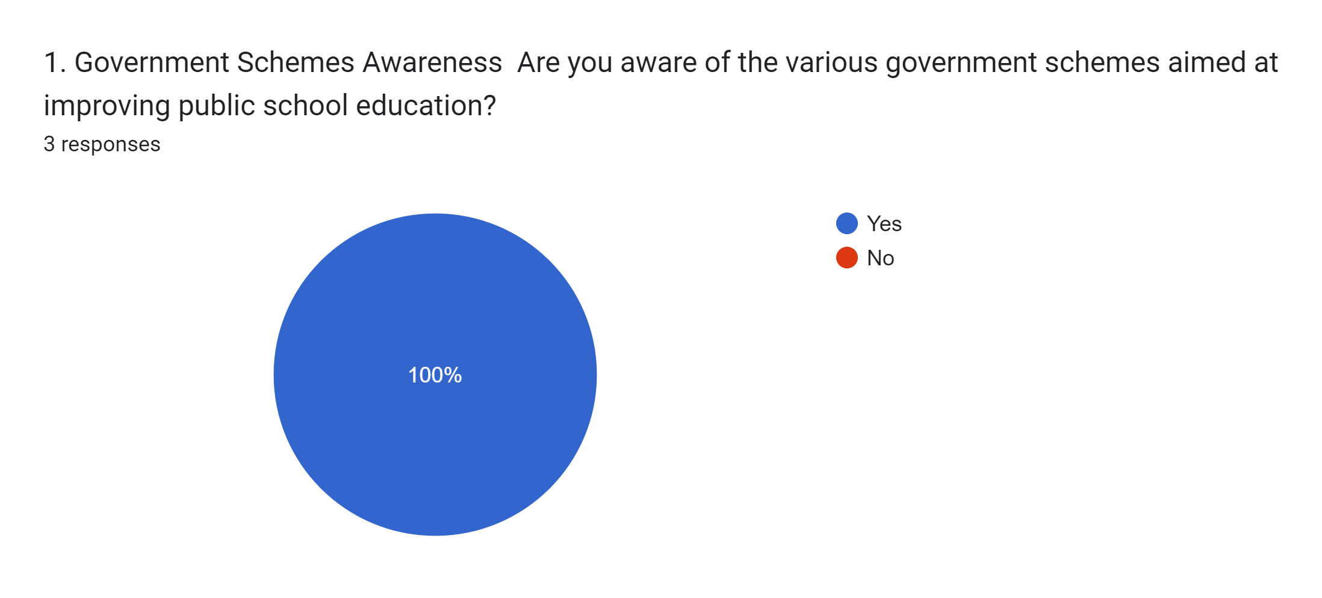
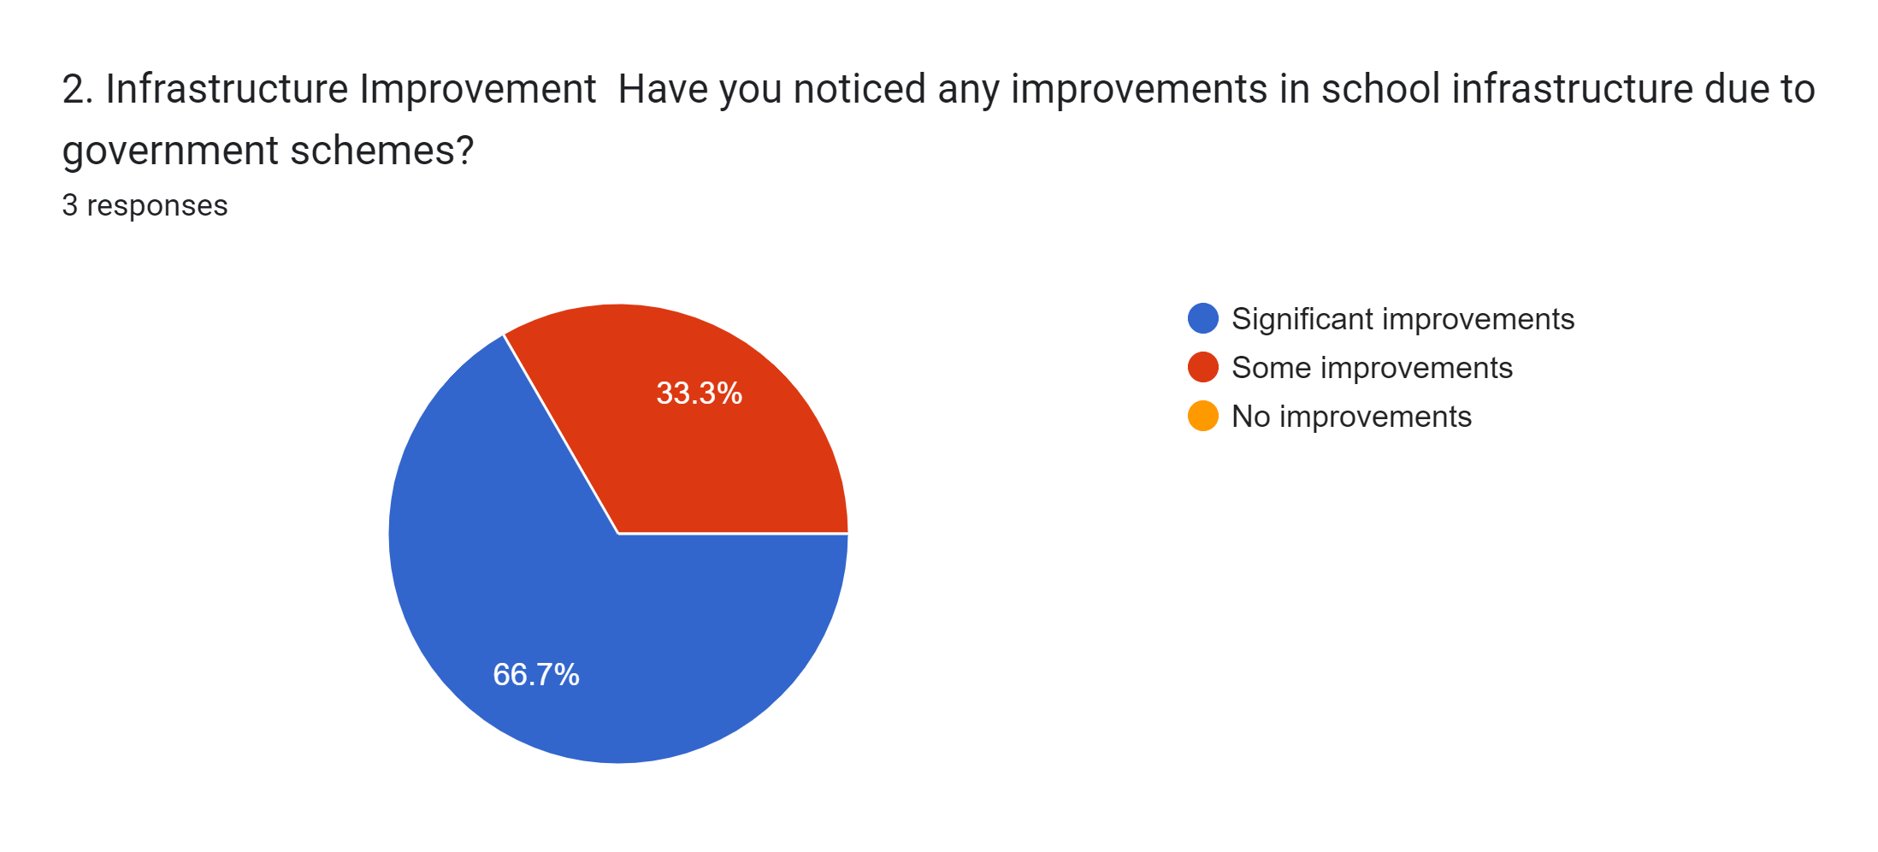

SECTION B : Analysis of data gathered from teachers through a questionnaire.

Slide 24
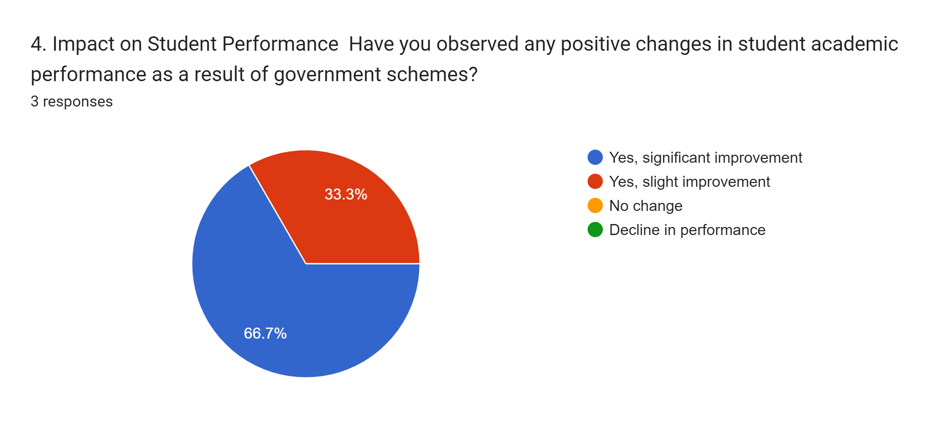
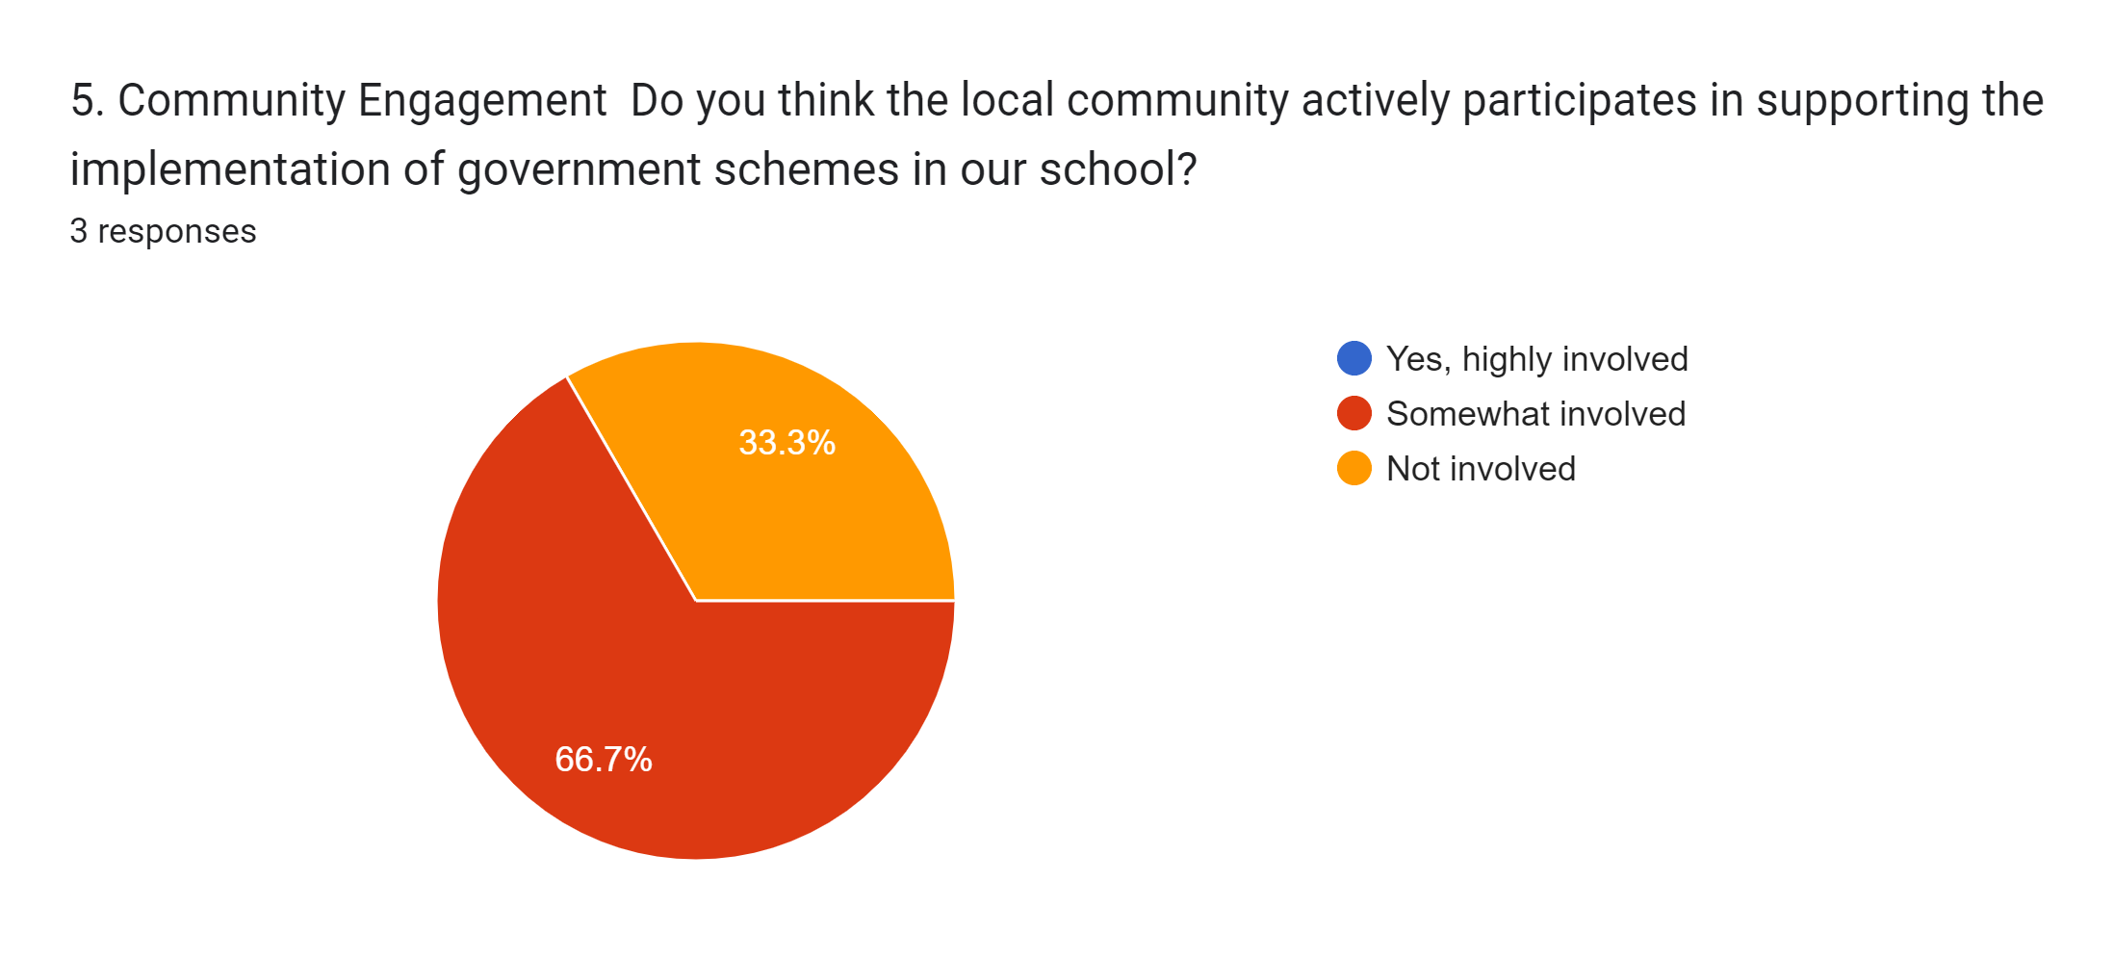


Slide 25
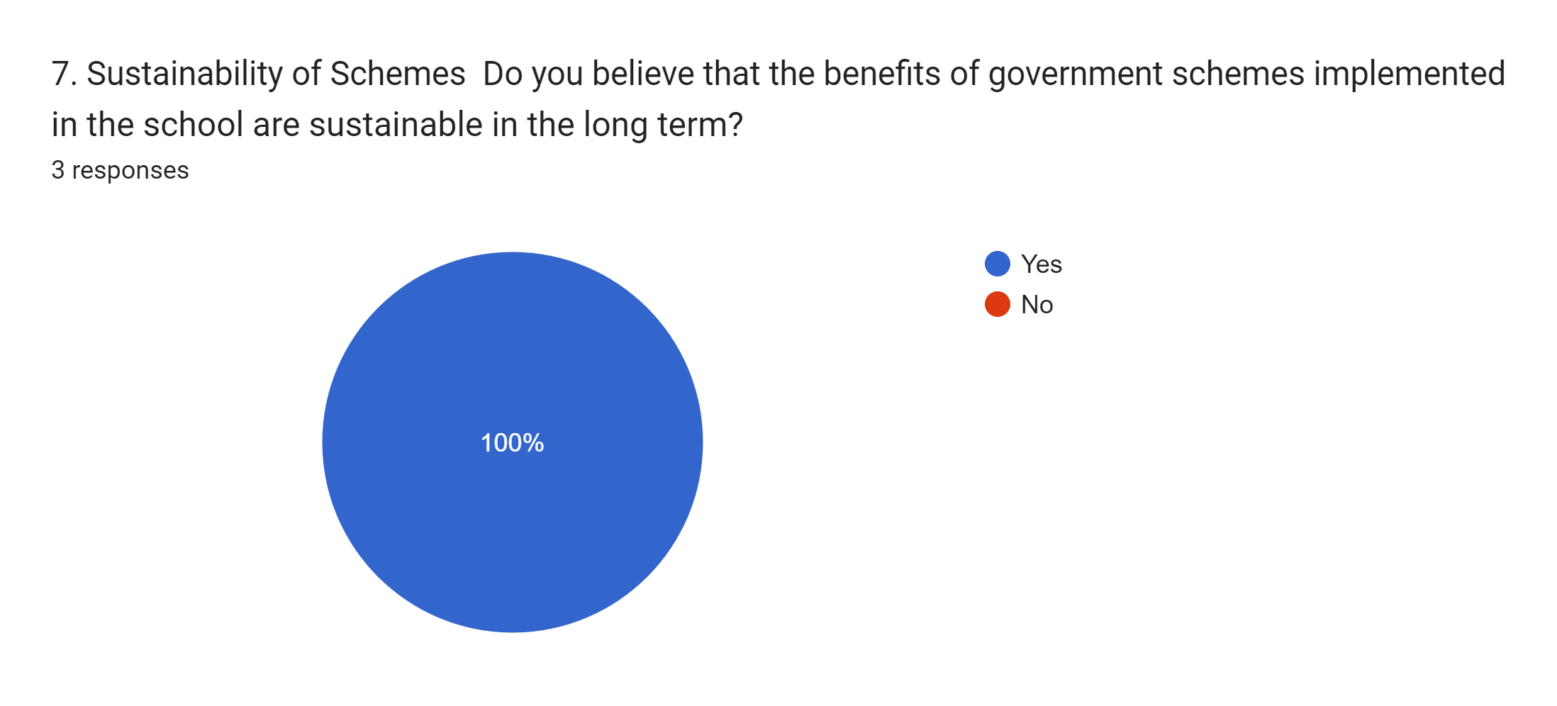
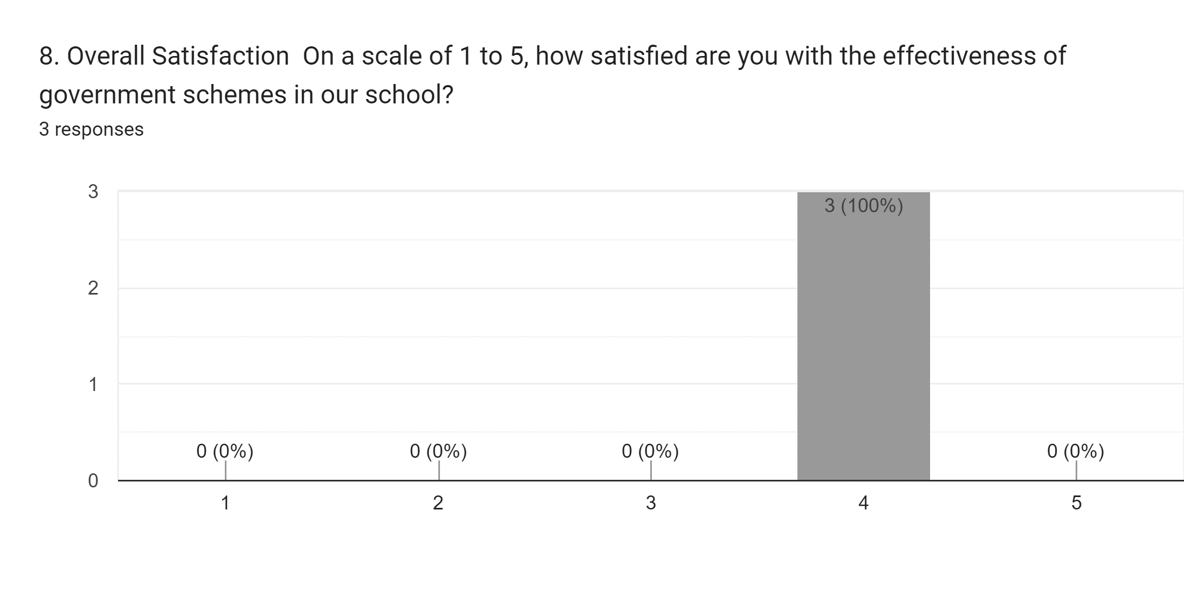
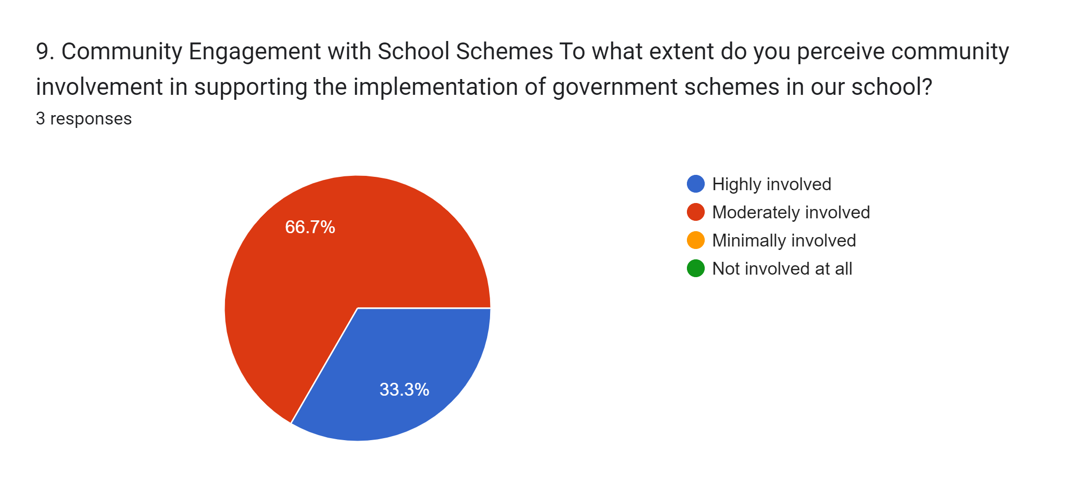

Slide 26
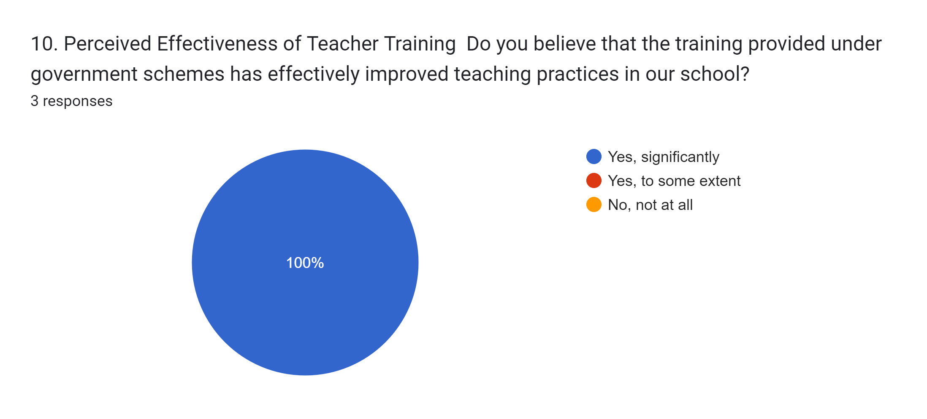
Conclusion
We aimed to gauge the perceptions of the teachers with respect to the impact of these schemes on teaching-learning processes. The analysis of Likert scale reveals that the teachers are aware of the impact of these schemes on the enrolment, attendance, classroom management, child’s performance and teaching-learning time of students. The findings of the Likert scale concluded that teachers were not able to teach students most of the time due to the scheme related work. Notebook evaluation, classroom teaching, interactions with students got hampered and teachers did not get ample time to design and implement learner centred activities. Merely awareness of these issues do not help in achieving the goal of “Education for All” but it has become essential to know the shortcomings of the whole process so that time of students, parents, and teachers can be saved and to reflect on the suggestions made by teachers and parents ; which would be further helpful in drafting policies.

Slide 27
RECOMMENDATIONS
Based on the conclusions drawn from the research, here are some recommendations that could be provided to the government, public schools, teachers in charge, and parents to increase the benefits of government schemes for students:
Streamline Administrative Processes : Simplify and streamline administrative processes related to the implementation of government schemes in schools to reduce the burden on teachers. This could involve digitizing paperwork, automating verification processes, and providing adequate training to teachers on efficient administrative procedures.
Designate Administrative Staff : Assign dedicated administrative staff or volunteers to handle paperwork, communication with parents, and coordination with higher authorities, relieving teachers of these responsibilities and allowing them to focus on teaching.
Enhance Infrastructure : Improve infrastructure in schools to support the implementation of schemes, such as providing computers and internet access for online submissions and communication, and establishing dedicated spaces for administrative tasks.
Provide Timely Support : Ensure timely support and assistance to parents in fulfilling scheme-related requirements, such as opening bank accounts or submitting necessary documents, to minimize disruptions to teaching-learning processes.
Training and Capacity Building : Conduct regular training sessions for teachers on managing scheme-related tasks efficiently while balancing their teaching responsibilities. Provide guidance on time management and prioritization to help teachers effectively handle administrative duties without compromising classroom instruction.
Promote Collaborative Efforts : Foster collaboration between schools, government agencies, and community organizations to share resources, best practices, and support services, thereby easing the burden on individual teachers and schools.

Slide 28
Enhance Communication Channels : Establish clear communication channels between schools, parents, and government authorities to facilitate smooth coordination and information exchange regarding scheme implementation, updates, and support services.
Encourage Parental Involvement : Encourage active involvement of parents in school activities and decision-making processes related to scheme implementation. Provide platforms for parent-teacher interactions and feedback to address concerns and improve the effectiveness of schemes.
Monitor and Evaluate : Implement robust monitoring and evaluation mechanisms to assess the impact of government schemes on teaching-learning processes regularly. Gather feedback from teachers, parents, and students to identify areas for improvement and make necessary adjustments.
Advocate for Policy Changes : Advocate for policy changes at the governmental level to address systemic challenges and barriers hindering the effective implementation of schemes. Lobby for increased funding, policy revisions, and policy adjustments to better support schools, teachers, and students.
By implementing these recommendations, stakeholders can work together to optimize the benefits of government schemes for students and create a more conducive learning environment in public schools.

Slide 29
REFERENCES
Tyagi, S. (2020). A Critical Analysis Of The Effectiveness Of Government Schemes On School Practices At Primary Level In Delhi.
Afridi, F. (2010). The Impact of School Meals on School Participation: Evidence from Rural India, Indian Statistical Institute Discussion Papers, No. 10-02.
Aggarwal, J.C. (1999). Development and planning of modern education .New Delhi: Vikash Publishing.
Aggarwal,Y.(2009).[Online]Availableat:http://shodhganga.inflibnet.ac.in/bitstream/10 603/10895/14/14_bibliography.pdf [Accessed 16 Feb. 2013].
Ahmad, A., (2006). Conditional Cash and Food Transfer Programs for Education in Bangladesh, presented at the Third International Conference on Conditional Cash Transfers, Istanbul, Turkey
Anderson, L.W. (1989). The effective teachers, study guide and readings. New York: McGraw Hill.
Andrabi, T, Das, J and Khwaja, Al. (2013).Report cards: The impact of providing school and child test scores on educational markets. Unpublished working paper. Available at http://elibrary.worldbank.org/doi/ref/10.1596/1813-9450-7362
Anon, (2019). [Online] Available at: https://www.academia.edu/11732075/STATUS_AND_SCOPE_OF_EEDUCATION_IN_INDIA [Accessed 22 Sep. 2014].
Anon, (2019). [Online] Available at: https://www.academia.edu/10390508/ primary stage of Education and quality concerns-A case study Anon, [Accessed 21 Jul. 2016].
Annual Report: (2002-2003), Ministry of Human Resource Development, India

